Slide 1
Redux Explained
A Very Special Presentation by Daniel “Code Whisperer” Stern
Notes:
https://imgur.com/gallery/ofyPi

Slide 2
Redux explained: roadmap
1) A workplace scenario
2) Redux Explanation
3) Building a Redux application
a) The Store
b) Reducers & Mutations
c) Rendering

Slide 3
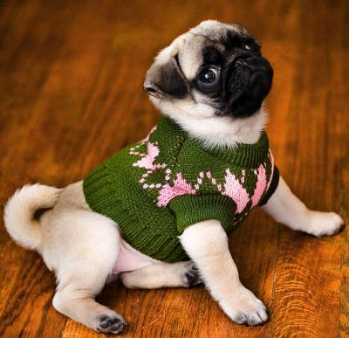
A Workplace Scenario: the special dog sweater company
Your company sells special sweaters for special dogs.
Your supervisor, L. Brador, informs you about an exciting website that you will be building, The Dog Wardrobe Simulator.
Users will be able to select from a variety of dogs, and see how they look in a number of different sweaters.
The Dog Wardrobe Simulator will be an application written in JavaScript and CSS, using Redux to manage state.

Slide 4

before we start – coding along
All code is simple and fits within one JS file
Node.js, Maven, Apache or any other tool to serve basic HTML pages is required
Full code available at https://github.com/danielstern/redux-app
Image files on GitHub are required to make functioning app

Slide 5

So just what is redux?
A JavaScript Library
Manages your application’s state: { name `Perdita`, breed: `Dalmatian` }
Makes it easy to access state but makes it hard to modify state
React is not required

Slide 6
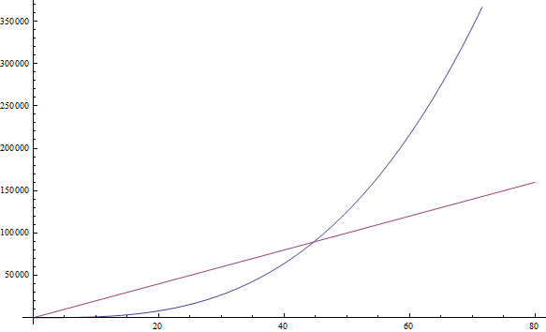
why bother with redux?
Redux scales very well
Linear growth in app scale usually results in cubic growth of complexity
Redux prevents this, causing maintenance complexity to scale more linearly
It’s a bit more complex at the beginning
Redux is easy to troubleshoot
Easy-to-access but hard-to-change state is easy to understand
Changes to state resulting in errors are easy to trace to their source
Complexity over time with Redux
Complexity over time without Redux

Slide 7

why do people conflate react and redux?
Redux developed by e-celebrity Dan Abramov
In his original egghead.io course, Abramov starts the lecture by setting up React
Subsequent students and teachers have been confused by this and think the two must go together
There is in fact no requirement that the two be used together

Slide 8
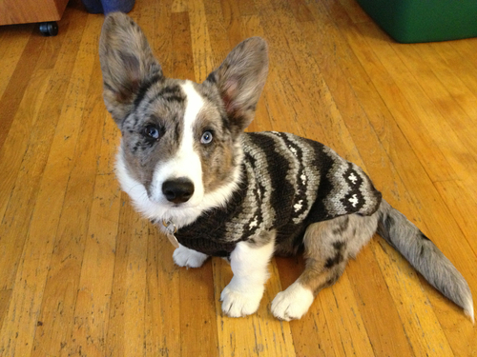
Dog wardrobe simulator: what are the variables?
- Name of dog
- Type of dog selected
- Type of dog sweater selected
- Color of dog sweater selected

Slide 9
Dog wardrobe simulator variables from point form list to Javascript object
List of things the application needs to remember
The Application State
- Name of dog
- Type of dog selected
- Type of dog sweater selected
- Color of dog sweater selected
{ name: 'Charles', type: CORGI, sweater: CARDIGAN, color: CHARTREUSE }

Slide 10
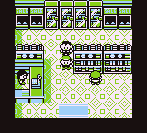
Building an app, part 1: The store
- All Redux applications have one (or rarely, more than one) store
- Store is the repository for all the information that gives your app its unique shape
- Store has default state which is like the skeleton of the app

Slide 11

Activity #1
Create a Redux Store
Notes:
create index.html, index.js and css file
Make sure website can be served
import Redux from CDN
create empty store with default state and no reducer

Slide 12

Mutations
Mutations change the application state
Mutations have a “type” which explains what it does, e.g.
CHANGE_SWEATER
UPDATE_DOG_BREED,
UPDATE_DOG_NAME
Mutations are dispatched to the Redux store

Slide 13
Using mutations to change the sweater
state = { name: 'Charles', type: CORGI, sweater: CARDIGAN, color: CHARTREUSE }
mutation = { type: CHANGE_SWEATER, sweater: TURTLENECK, }
result = { name: 'Charles', type: CORGI, sweater: TURTLENECK, color: CHARTREUSE }

Slide 14

Activity #2
Adding Mutations
(And HTML and stuff)
Notes:
create index.html, index.js and css file
Make sure website can be served
import Redux from CDN
create empty store with default state and no reducer

Slide 15
Redux recap: Key terms
State – What’s up with your application
Store – Where the state goes
Mutation – Something that tells the state to change
Dispatch – How you give a mutation to the store

Slide 16
the reducer
A function that always returns the application’s state
The “brain” of the Redux store
Takes a second argument, called an action or mutation
Mutation can result in a different application state
function (state, action) { return state; };

Slide 17

world’s most basic reducer (I/III)
function (state) { return state; };

Slide 18

world’s most basic reducer (ii/iii) adding machine edition
function (state = 0, action) { if (action.type === `INCREMENT`) { return state + 1; } return state; };

Slide 19

world’s most basic reducer (iii/iii) switch edition
function (state = 0, action) { switch (action.type) { case `INCREMENT`: return state + 1; case `DECREMENT`: return state - 1; default: return state; } };

Slide 20

Activity #3
Creating the reducer and finalizing the app
Notes:
create index.html, index.js and css file
Make sure website can be served
import Redux from CDN
create empty store with default state and no reducer

Slide 21

challenges
Add an input for name and have the name superimposed on the image
Update the application so when the user refreshes the page, it remembers their preference
Add more colors and fetch the image from the web using Ajax (hard)

Slide 22
Review
Redux manages your app’s state
Redux can manage the underlying data for a React application, but takes no part in rendering
Redux provides a store which provides easy access to state but restricts modifying it
Mutations can be interpreted by a reducer to change the state
Thanks!

